Slide 1
Introduction
Architecture
Why AVDF
Use Case
Resources
Oracle AVDF

Slide 2
Introduction
Oracle Audit Vault and Database Firewall (AVDF) is a comprehensive, enterprise-level security solution designed to help organizations secure their databases and meet regulatory compliance requirements. It achieves this by collecting, consolidating, analyzing, and storing audit logs from a variety of sources such as databases, operating systems, and directories.
AVDF also provides a Database Firewall that monitors and controls SQL traffic in real time, preventing unauthorized access or malicious activities before they reach the database. It is specifically built to address the dual challenges of data security and compliance.

Slide 3
Audit Vault Server
The Audit Vault Server is the central repository and management console for AVDF. It performs the following roles:
Audit Data Collection
Collects audit data from various sources (e.g., Oracle Database, SQL Server, MySQL, and more).
Uses secure communication channels to retrieve audit data via agents installed on the source systems.
Data Consolidation and Analysis
Aggregates audit data into a central repository.
Analyzes data for patterns or anomalies to identify potential security incidents.
Data Retention and Archiving
Ensures long-term storage of audit data for historical analysis and compliance requirements.
Allows administrators to define retention policies.

Slide 4
Database Firewall
The Database Firewall acts as a protective layer between applications/users and the database. Its primary functions include:
SQL Traffic Inspection
Monitors all SQL traffic between clients and the database.
Parses SQL statements to understand the context and intent of each query.
Policy Enforcement
Applies security policies to SQL traffic based on predefined rules:
Block: Rejects unauthorized or suspicious SQL queries.
Alert: Flags and logs suspicious queries for review.
Pass: Allows legitimate traffic to proceed.
Learning Mode
During the initial setup, the firewall can operate in "learning mode" to analyze and establish a baseline of typical database activity.
Administrators use this baseline to create tailored policies.

Slide 5
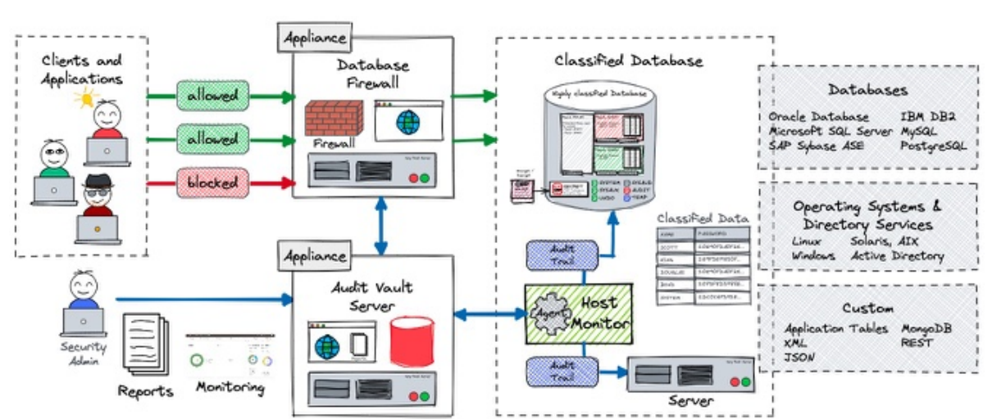
Architecture

Slide 6
Why AVDF
Key Features
Oracle Audit Vault Improves Database Performance
Centralized Audit Data Collection
Real-time Monitoring
Advanced Reporting and Analytics
SQL Traffic Control
Integration with SIEM
Offloading Audit Processing
Real-time Threat Prevention
Streamlined Audit Management
Proactive Performance Tuning
Reduced Data Breach Impact
Policy Enforcement Without Application Changes

Slide 7
Use Case
Firewall Filtering: The Database Firewall detects and blocks malicious SQL queries, reducing unnecessary processing.
Audit Offloading: Audit logs are stored in the Audit Vault Server instead of the production database, reducing storage and I/O strain.
Efficient Reporting: Prebuilt compliance reports eliminate the need for resource-intensive in-database reporting queries.

Slide 8
Resources
Hardware Requirements For Audit Vault Server
Processor (CPU): Minimum of 4 cores, recommended 8+ cores for high-volume environments.
Memory (RAM): Minimum 16 GB, recommended 32 GB or more for large-scale implementations.
Storage:
Disk space depends on the expected volume of audit data. A baseline is:
500 GB for small deployments.
1 TB or more for larger organizations with high data retention needs.
High-performance storage (SSD or RAID) is preferred for faster data processing and retrieval.
Network:
Gigabit Ethernet (1 Gbps) for reliable connectivity with monitored databases and database firewalls.
Multiple NICs if using a dedicated management network.
Hardware Requirements For Database Firewall
Processor (CPU): Minimum of 4 cores, recommended 8 cores.
Memory (RAM): Minimum 8 GB, recommended 16 GB.
Storage: At least 250 GB for log storage and temporary caching.
Network:
Gigabit Ethernet (1 Gbps) for real-time traffic inspection.
Placement of the firewall between application servers and databases may require multiple network interfaces.

